Slide 1

Digital Design Principles
Unit 4 | Chapter 23 | Mr Butler

Slide 2


What is computational thinking?
An approach to problem solving that people use to define a problem and create a solution which can be carried out by a computer or individual.

Slide 3
The Underlying Concepts of Computational Thinking
ABSTRACTION
Removing specific details from a problem which are not required to solve it. It involves filtering out characteristics that are not required and focusing on general characteristics to create a model.
PATTERN RECOGNITION
Observing key characteristics, patterns, and trends in the data being considered.
DECOMPOSITION
Breaking a large, complex problem down into smaller, more manageable problems called sub-problems.
ALGORITHM DESIGN
The process of creating a step-by-step set of instructions which specifies how the problem is going to be solved.
Usually completed in pseudo-code or flowcharts.

Slide 4
Algorithm Design: Flowcharts
A flow diagram or flowchart is a graphical representation of the solution to a problem
  Uses special symbols to represent different operations
  Flow lines represent the sequence of operations and arrows show the direction of flow

Slide 5
Graphic | Symbol | Purpose
 | Flow line | Indicates the flow of logic and connects the different symbols together
 | Terminal (stop/start) | Represents the start and end of the flowchart
 | Input/output | Indicates the input/output of data
 | Process | Indicates that an operator is to be done. There is usually text in the rectangle
 | Decision | Asks a question. Can impact pathways via different responces
 | Sub-routine symbol | Represents a call to a sub-routine
 | Document/report | Indicates that a report/document is produced

Slide 6
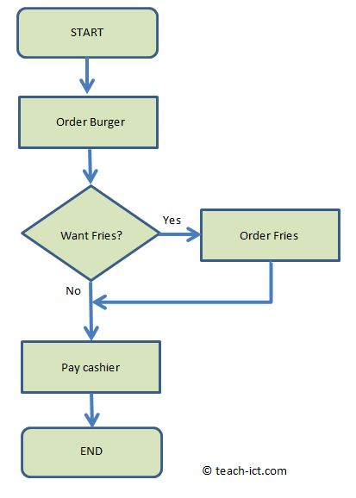
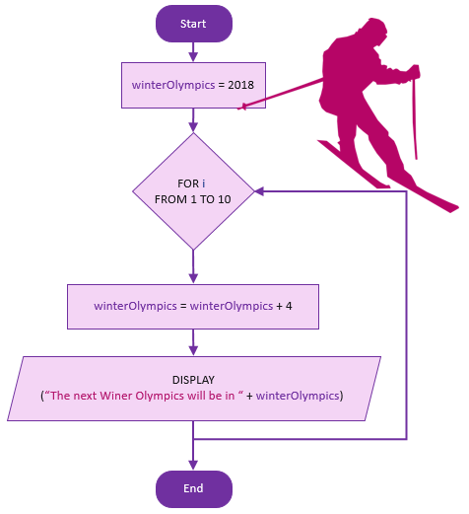
Quick Examples

Slide 7
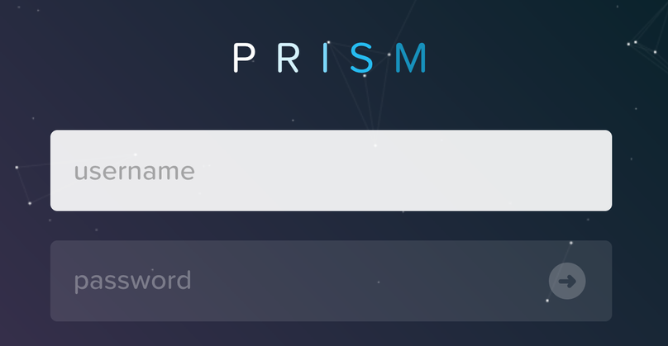
Activity: Create Your Own
Create a Flowchart for the following scenario:
  A user needs to enter a username and password
  If these match what is on file, the user should successfully login
  If the authentication fails, an error message should appear.

Slide 8
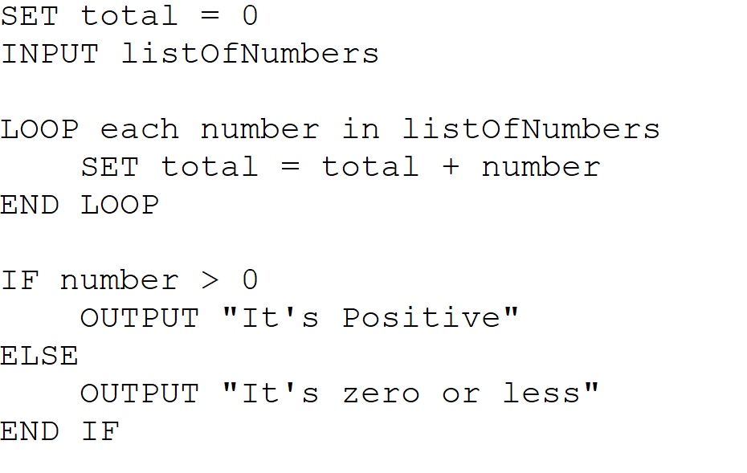
Algorithm Design: Pseudocode
Pseudo-code is a way of describing a solution to a problem
  A program can be written directly using pseudo-code
  It uses keywords and control structures in a similar way to C#
Closer to code, or ‘half code, half English’
English like instructions which represent a solution to the problem, showing a solution step by step by representing the flow/logic of the solution. It is used to design a program.

Slide 9
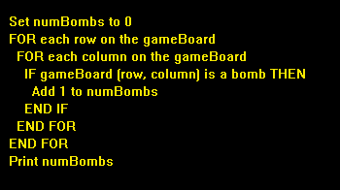
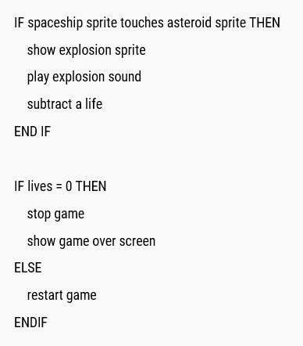
Quick Examples
Notes:
These aren’t perfect, but give you the idea.

Slide 10
Best Practice for Writing Pseudocode
Keep it Language independent (half code, half English)
    Write your instructions using plain English to start with (ensuring it’s logical), then make it more “code-like”
    Try to start your instructions with verbs such as INPUT, PRINT, SET to get a user input, output something to the user, or assign a variable.
Use capitalised Control Structures (Selection and Iteration)
    Use IF… ELSE … END IF in alignment
    For iteration, use
      FOR …. END FOR
      WHILE … END WHILE
      DO … WHILE
      When you need to loop a piece of code.
Use indentation
    If a line of code is within a loop, keep it indented. If not, keep it in line with the previous line of code!
    When ending a loop such as adding an “END IF” or “END WHILE”, it should be in line with the loop declaration
Notes:
We’ll look at this more shortly.

Slide 11
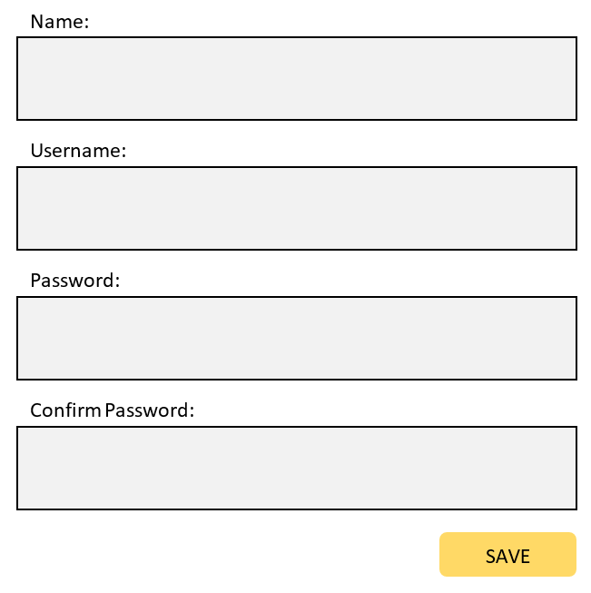
Activity: Create Your Own
Create a section of pseudocode for the following scenario:
A register screen for a new staff member. They need to enter their name, username, password and password confirmation.
The name should be at least 3 characters long
Their username should be unique (not in a stored listOfUsernames) and over 5 characters
The password should be at least 8 characters
The password and password confirmation should be the same.
If any of these events fail, an error message should be displayed. If there are no errors, the user should be added to the system using a saveUser() method.

Slide 12
Program Control Structures
SEQUENCE
Executing all lines of code in a program in a sequential, step-by-step manner
This is the default order in which instructions are carried out by the computer, where simple programs run from beginning to end, one statement after another (e.g., Step 1, then Step 2, then Step 3)

Slide 13
Program Control Structures
Selection
Executing lines of code based on the outcome of an IF-Statement
Selection is the ability to specify different execution paths in an algorithm so that certain steps are only carried out if specified conditions are met.
The sequence of instructions is dynamically changed based on the value of variables within the program, which is achieved using IF and ELSE statements combined with Boolean operators

Slide 14
Program Control Structures
Iteration
Executing lines of code repeatedly in the form of loops.
Iteration (commonly known as looping) is used when a section of code needs to be carried out more than once. It allows steps to be repeated either a given number of times, or until a specific condition has been met.
Programming languages divide loops into two distinct types:
  Unconditional loops: These repeat code a pre-determined, known number of times (such as a standard FOR loop).
  Conditional loops: These repeat code for an unknown number of times, continuing until a particular condition evaluates to true or false (such as a standard WHILE loop).

Slide 15

Unconditional loops
  Unconditional loops will repeat a
  known number of times.
  for(int i = 0; i < 52;i++)
  {
  MessageBox.Show(“Go for another lap!”);
  }
Number of Laps to Complete: 52

Slide 16
Condition Controlled Loops
  This is when the loops will run for an unknown number of times
  Will repeat until a particular condition is true of false
  while(stillHaveFuel = True)
  {
  MessageBox.Show(Do you still have fuel?”);
  stillHaveFuel = Input.Text;
  }

Slide 17
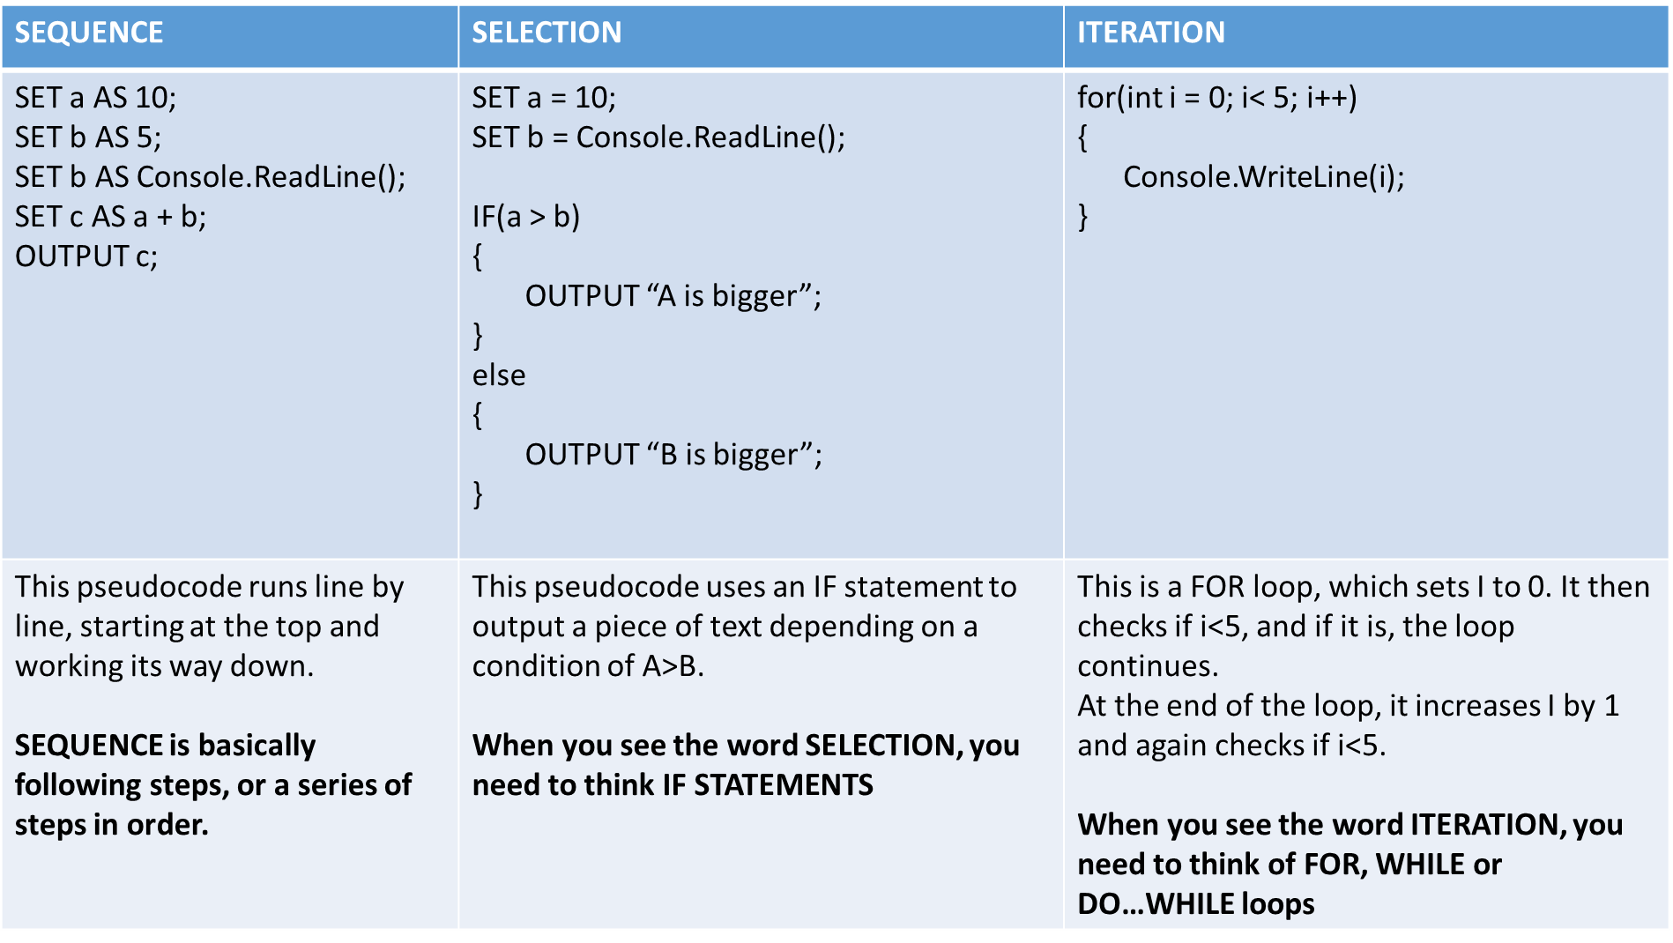

Slide 18
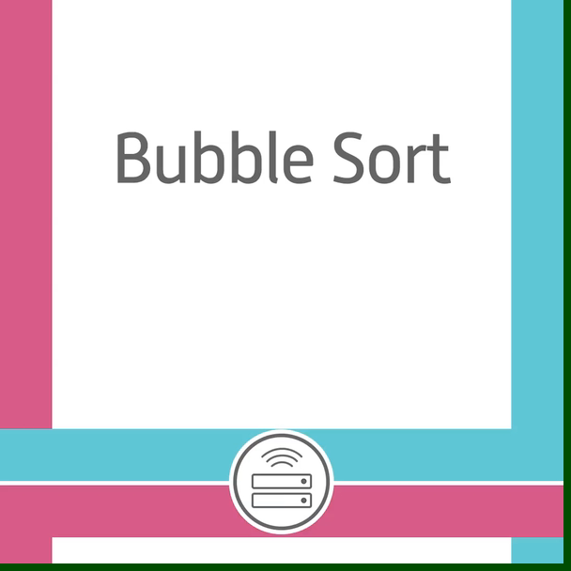
Sorting Algorithms: Bubble sort

Slide 19
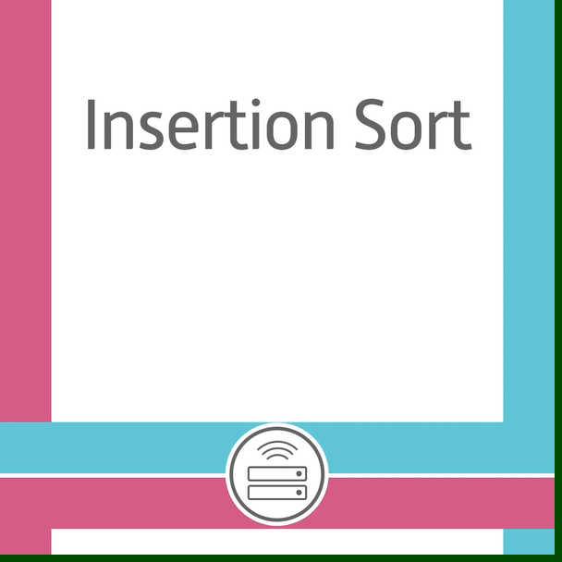
Sorting Algorithms: insertion sort

Slide 20
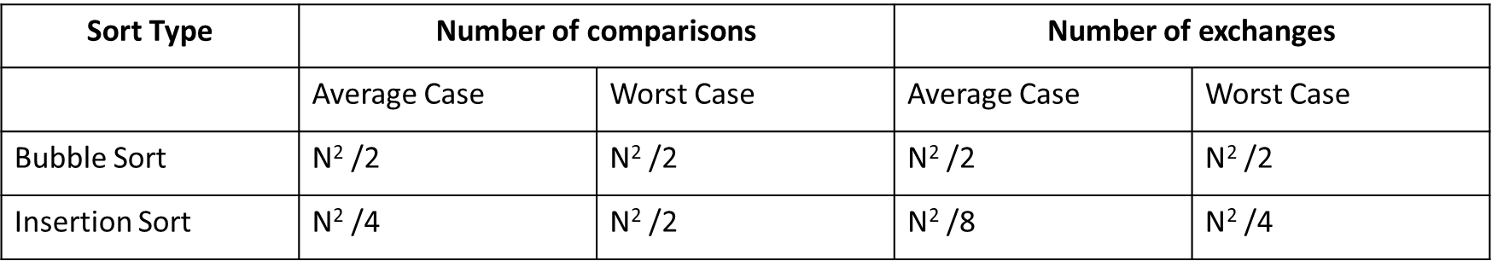
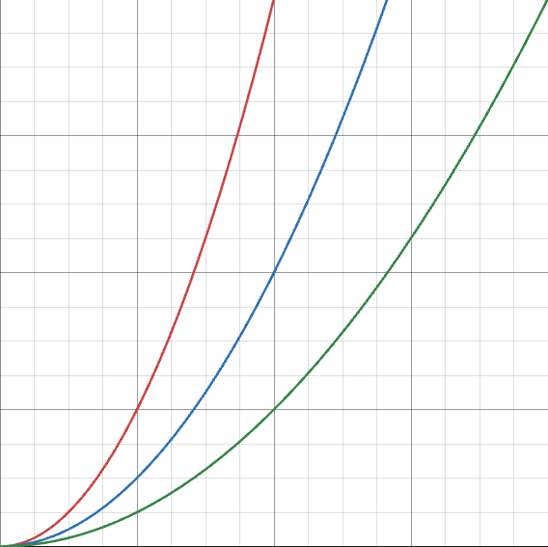
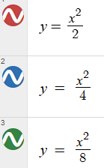
Bubble Sort Vs Insertion Sort
N = Number of data items
Time
Number of data items

Slide 21
Algorithms for Searching
Used to locate and return data given certain criteria
Each algorithm has benefits and limitations
Sorting data in advance of searching can make a search more efficient
Work with data structures such as arrays

Slide 22
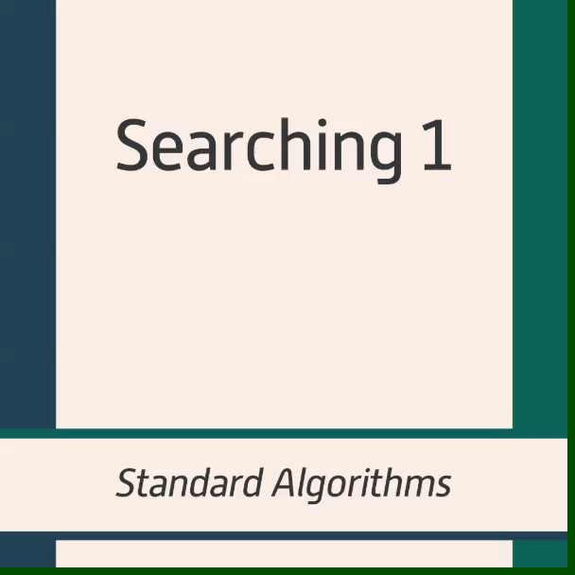
Searching Algorithms: Linear Search &
Binary Search

Slide 23
Linear Search
Simple search technique
Every data item is examined in order to see if it matches the target value being searched for
In a linear search, the average number of attempts required to find a target value is half the number of data items
Binary Search
Much more efficient than linear search
Only works on data that is sorted
Starts by looking at the middle of the list and compares this to target value.
  The search determines if the target value is below or above the middle location
  The process is repeated and the number of items being searched through the ‘search space’ is decreased until eventually there is only one item to be searched through
Number of data items to search through is log₂N

Slide 24
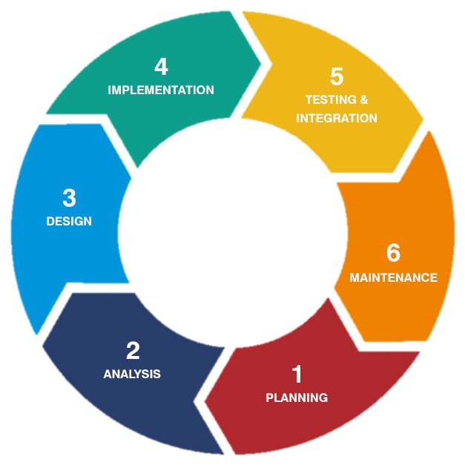
Designing Solutions: Models
Several models for designing solutions
Traditional development involves following a development life cycle from beginning to end
  User is not involved after the analysis stage
Agile development methods allow user to be closely involved with development
  User can review each section and give feedback to developer who can make the necessary changes

Slide 25
Identifying Data Requirements for a Solution
Data Requirements:
  The data that a program or system will use including data input, information output and any values to be stored temporarily during processing
It is important to plan the data requirements for the solution in advance
The test plan will be used to check that the program works as expected
  Identifies errors in logic of the design
  Can be corrected and design improved as a result
 | Data Item | Data Type | Sample Valid Data | Function of Data Item
1 | Name | String | Mr Butler | Stores the username for use in the login
2 | … | … | … | …

Slide 26
Developing an Appropriate User Interface
The part of the system the user will interact with and use to operate different functions
Very important to be user friendly. This can be achieved by:
  Presenting information clearly and concisely
  Using colours, icons and messages in a consistent manner
  Placing menus, messages, buttons in the same place throughout
  Efficient system which is responsive and does not have lengthy loading times
  Supports users if they make a mistake (error messages/feedback)
  Interface focuses on user experience, which has a visual appeal that is attractive to the user
GUI = Graphical User Interface

Slide 27
Using a Dry Run to Test a Solution
This is a paper based exercise which allows the programmer to work through a solution using test data, presenting this in a tabular format.
Can make use of a dry run at design or coding stages
Involves creating a trace table with a list of variables and checking the value of the variables after each line of code has been executed
Identifies errors in logic of the design and any omissions and incorrect results, mainly used in whitebox testing.
The IDE provides debugging facilities whilst the program is running
How Dry Runs Work
The programmer creates a trace table
Each line of code is written on a separate row
The variables are written in columns
The programmer then traces through each line of code, writing the value of the variables after each line.
These values are entered into the table.

Slide 28
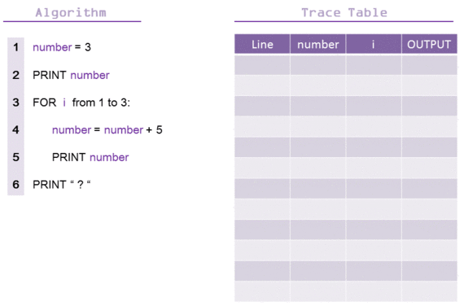
Creating a Trace Table
To create a trace table:
  Number each line of code/pseudo code
  Create a table structure
  Create a column for each variable in the section of code
  Add an output column to show any output generated from the code

